Slide 1
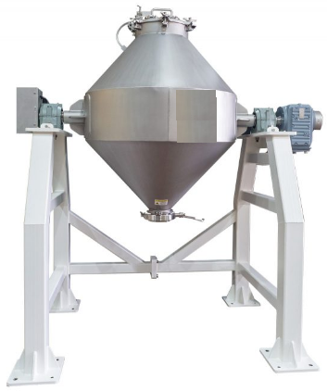
DOUBBLE CONE BLENDER
Mfg.& Exp. Of Plants & Machineries for Pharmaceuticals,
Cosmetics, Chemicals food & Beverage Industries
Plot No. 1601/1,3rd Phase G.I.D.C., Vapi-396195. (Gujarat)
Email:sales@sidhipharmaequiment.com:sidhipharmaequipments@gmail.com:
Contact Person : Mr. Pravin Panchal (9924893790) Mr. Kiran Gophane (9545868896)
Website: www.sidhipharmaequipment.com

Slide 2
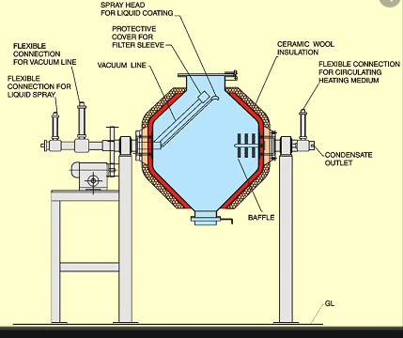
Double Cone Blender :
Blenders are used for mixing, lubricating and blending in Pharmaceutical, Nutraceutical, Food, Chemical, cosmetics, ceramics, pesticide, plastics and other Allied industries
The Double shape blenders have long two corner of product container for more rubbing and tumbler effect to the material for fast and homogenizing mixing. It can perform homogenously dry mixing of free flowing powders, granules requiring low shearing force, Mixing and Blending of particles with rapid intermixing of particles irrespective of varying specific gravities. The material is loaded into the double cone blender drum. The double blender is tumbles the material in the container and spread out. The mixing is achieved in 5 to 15 minutes with better homogeneity.

Slide 3
Silent Features :
Design is cGMP – Current Good Manufacturing Practices compliance
All Product contact parts AISI 316 & non contact parts AISI 304.
Double Cone shape product container for Ideal dry mixer for lubrication of granules and homogenization mixing of multiple batches in to single batch.
Enclosed rigid drive with reduction gear box and motor.
Product container having discharge with butterfly valve and man hole.
Charging hole with hinged lid with seal for charging and cleaning.
The product container rotates on sped 8 RPM.
Safety reeling provided for rotating area of product container.
Fixed baffles provided for lumps braking.
Electric controls panel with cycle time.
Advantageous\ Benefits :
It is efficient for mixing powders of different densities.
Material is loaded and emptying is done through same port.
Mixing occurs due to tumbling motion
The rate of rotation should be optimum depending upon the size, shape
of the tumbler and nature of the material to be mixed.

Slide 4
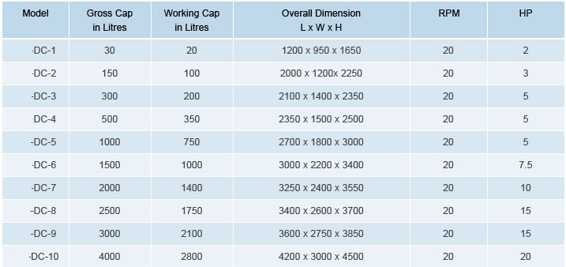
Technical Specification :
Single Source Provider for all your technical requirements.
One of the most important “Siddhi Pharma Equipment” guideline is to be closest to our Customers. We strive to create end-to-end solutions that meet our clients needs and their expectation.
Application :
Pharmaceutical
Food
Chemical
Cosmetics
Allied Industry

